Slide 2
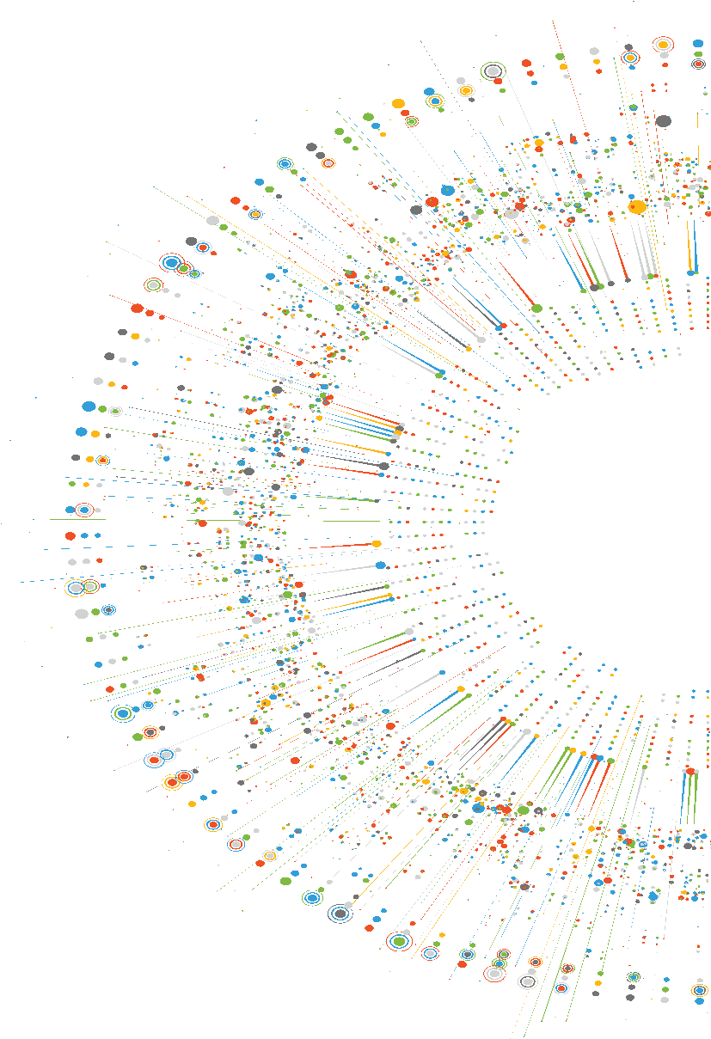

FACUNDO GIULIANI
Software Engineer
Lead Web Developer @ MultiTracks.com
Auth0 Ambassador
GitKraken Ambassador
Cloudinary Media Developer Expert
Web fgiuliani.com
Twitter @facundozurdo
GitHub @fgiuliani

Slide 3
Jamstack, static sites and Azure

Slide 4
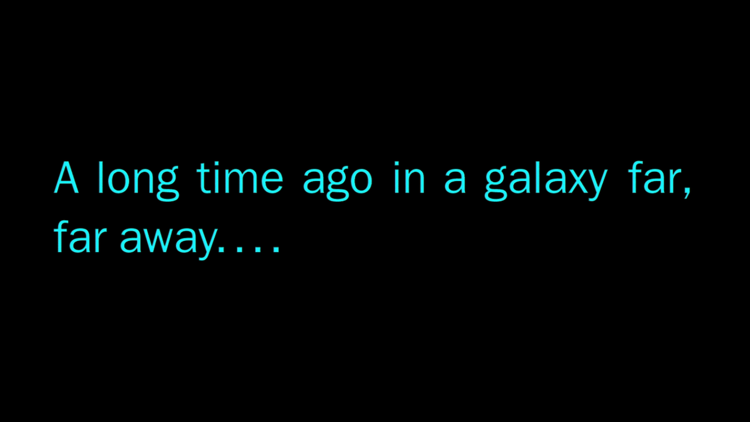

Slide 5

Tim Berners-Lee

Slide 6
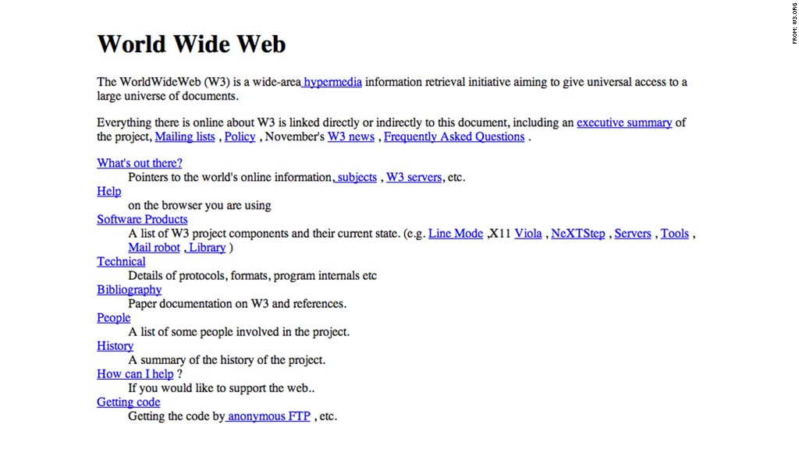
http://info.cern.ch/hypertext/WWW/TheProject.html

Slide 7
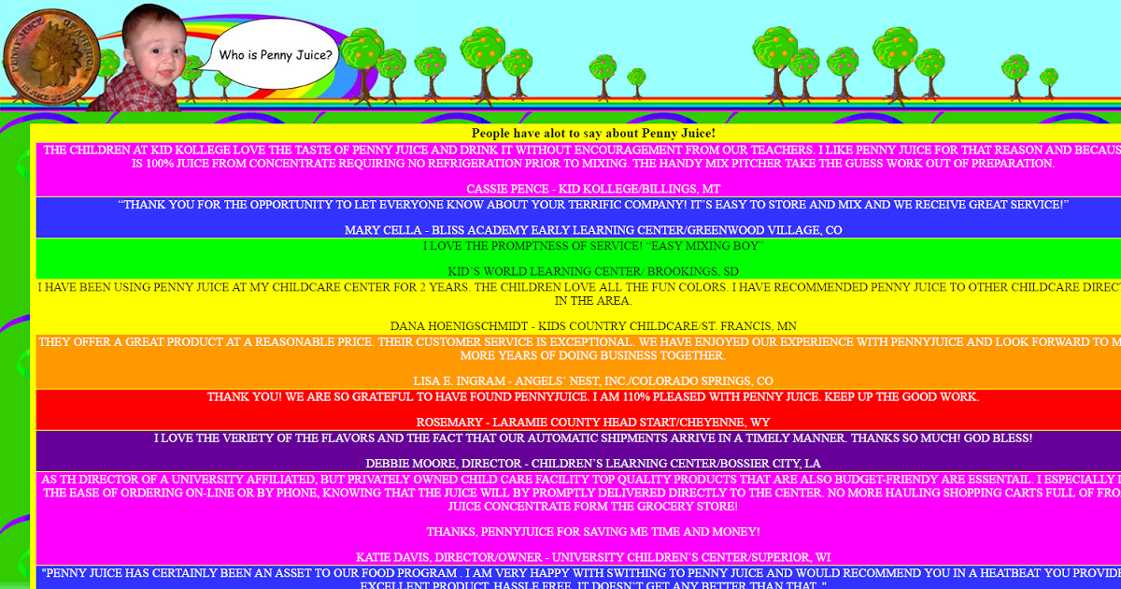

Slide 8
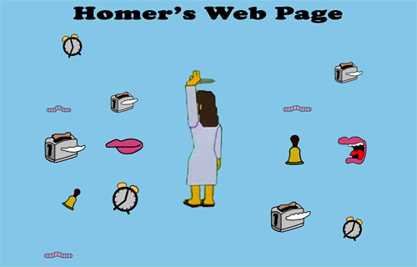

Slide 9
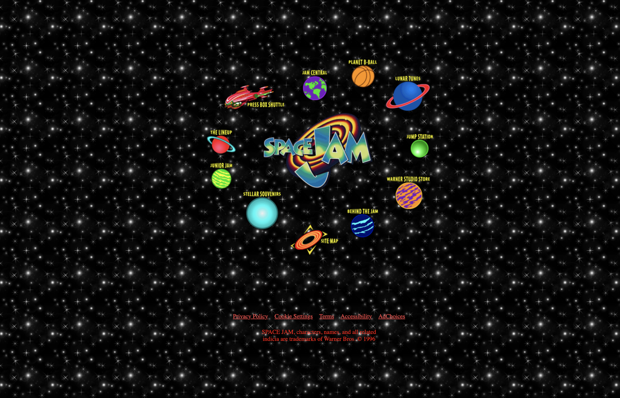
http://spacejam.com

Slide 10
Static Web Page
A web page that is delivered to the user's browser exactly as stored

Slide 11
Dynamic Web Page
A web page where some of the content is generated dynamically, when needed

Slide 12
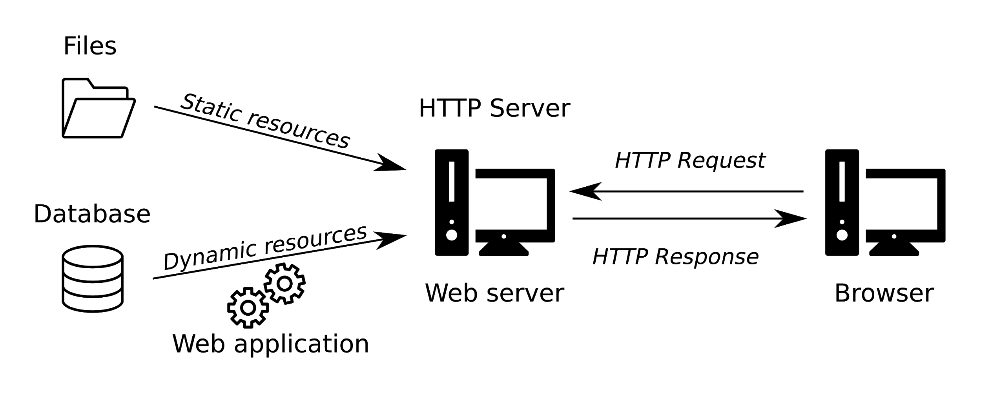

Slide 13




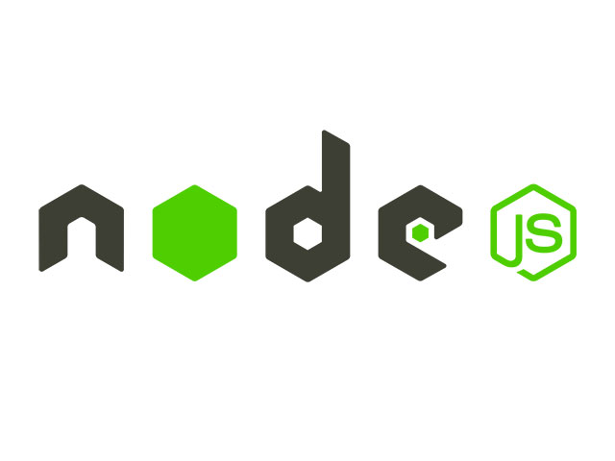


Slide 14
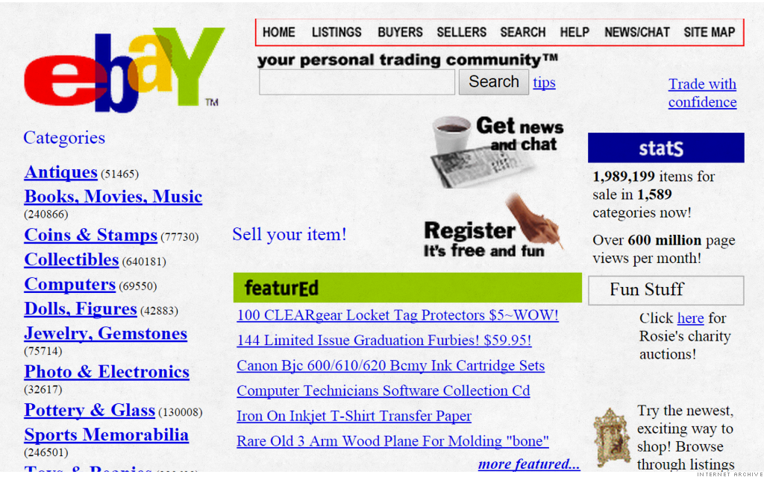

Slide 15
Server Side Rendering
The HTML content is generated by the Web Server

Slide 16


Slide 17

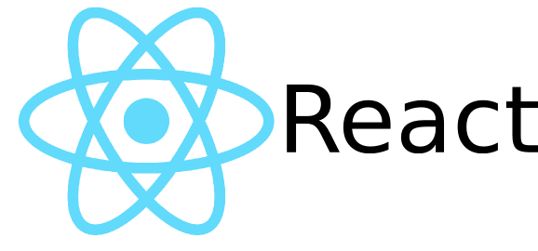



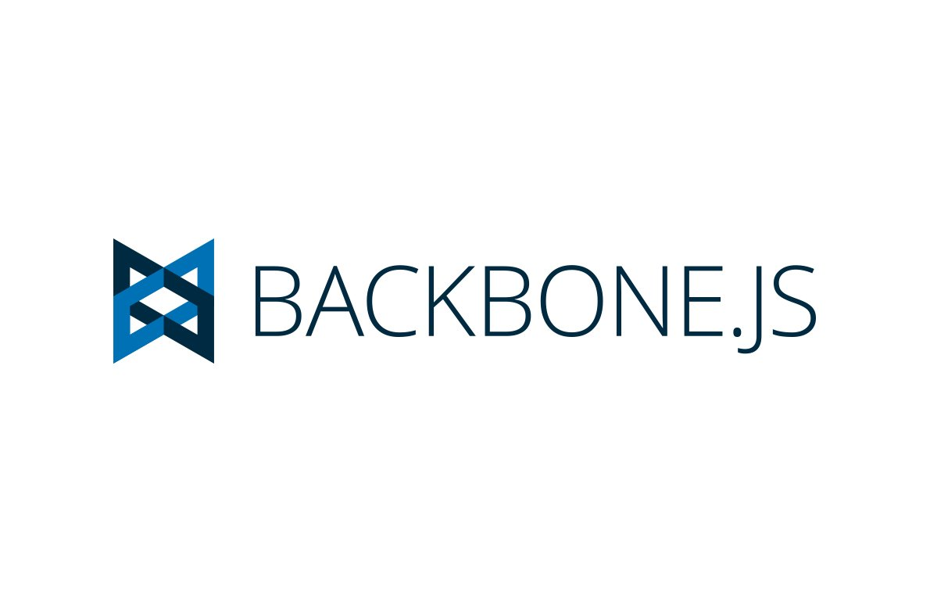

Slide 18
Single Page Application
A web application that interacts with the user by dynamically rewriting the current web page with new data from the server

Slide 19
Client Side Rendering
The HTML content is rendered directly in the browser using JavaScript

Slide 20
Client Side Rendering
PROS
CONS
Richer interactions.
Faster rendering after initial page load.
Lower server load.
Reusable UI components.
Slower initial page load.
Low SEO If not implemented correctly.
Dependency on external libraries.

Slide 21
Server Side Rendering
PROS
CONS
Faster initial page load.
Better SEO / Social Media Optimization.
More secure (server-side code).
Lower user device load.
Busier web servers.
Overall slow page rendering.
Full page reload after route changes.
The page is viewable sooner, but it’s not interactive.

Slide 22
One Step
Forward Backward

Slide 25
Static Web Pages
Fast
Cheap
Easy to maintain
Secure
Easy to scale
Stable

Slide 26
Jamstack

Slide 27
Jamstack
A new way of building websites and apps that delivers better performance, higher security, lower cost of scaling, and better developer experience.

Slide 28

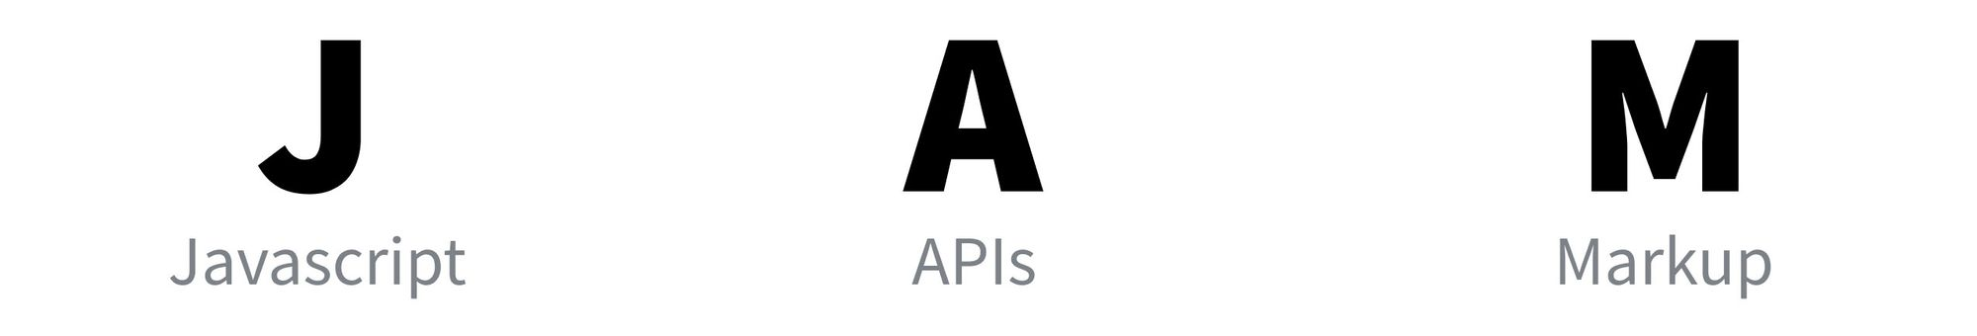

Slide 29
Generating cacheable, static assets at build time whenever is possible

Slide 30
Deploying those assets to CDNs

Slide 31
Use client-side JavaScript to call third-party APIs and serverless functions for dynamic interactions and data

Slide 32
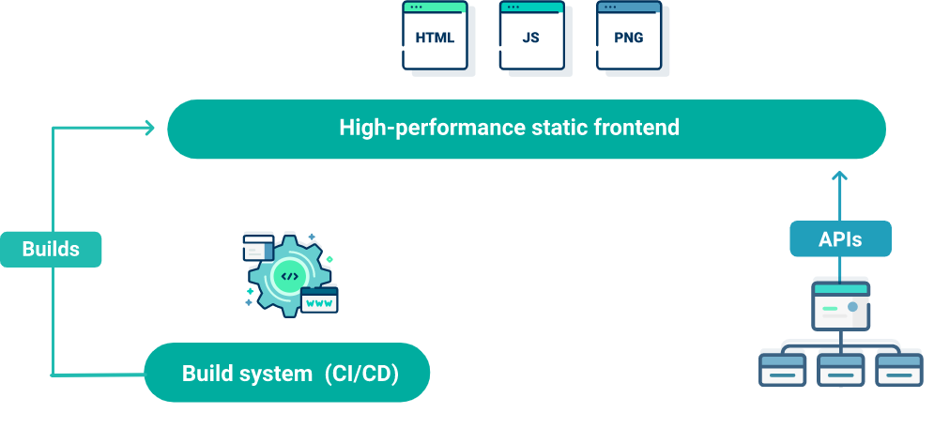

Slide 33
Static Site Generator
Software that produces and deploys a static website using data sources and templates

Slide 34
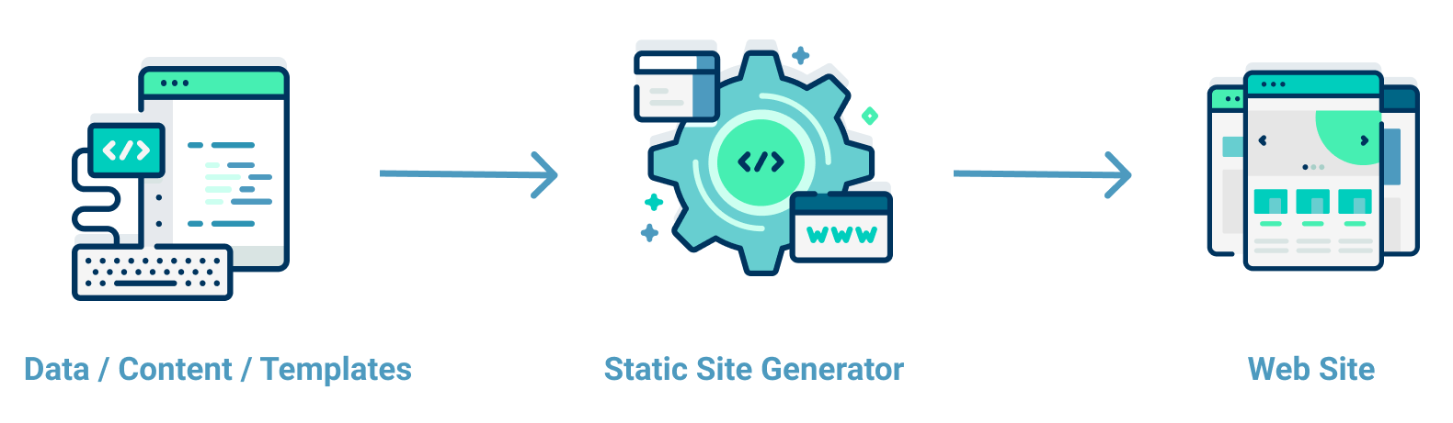

Slide 35







Slide 36
Content Management System
Application or set of related programs that are used to create and manage digital content

Slide 37
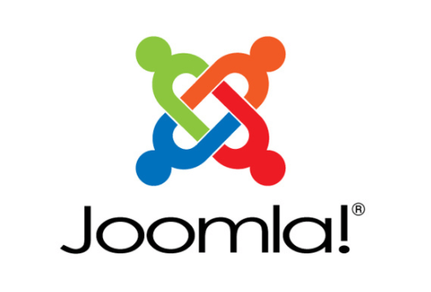



Slide 38
Headless CMS
A CMS where the content repository is separated or decoupled from the presentation layer

Slide 39




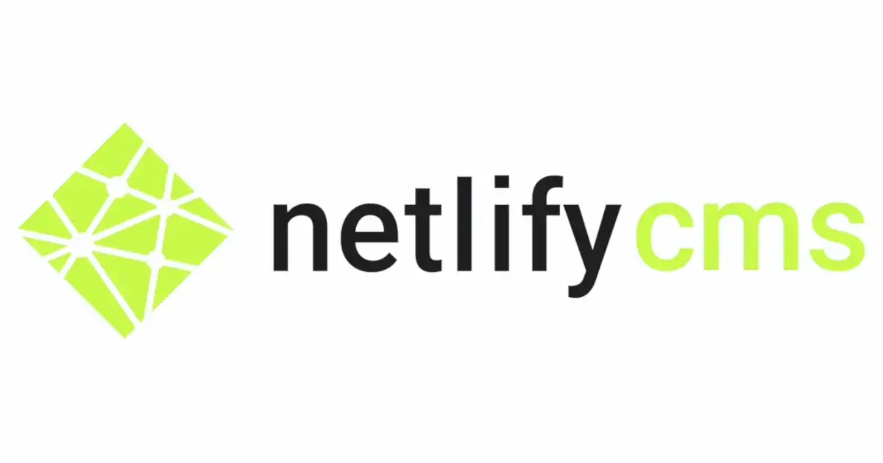



Slide 40
Build, Deployment and Hosting
Service to build, integrate, deploy and host the application

Slide 41




Slide 42
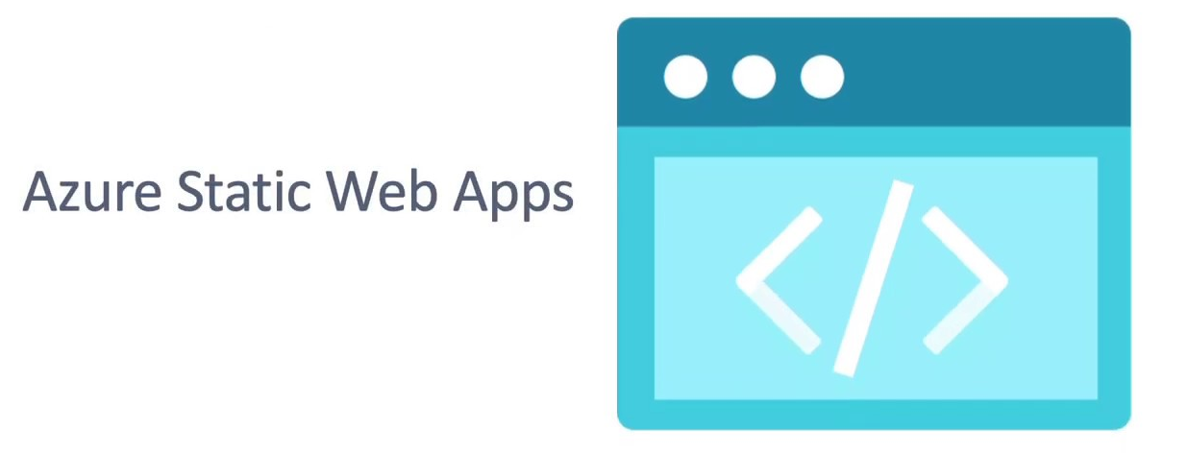

Slide 43
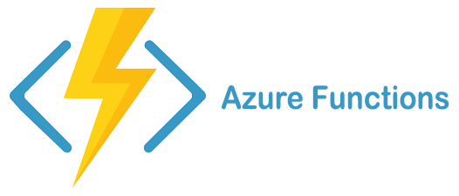

Slide 44


Slide 45


Slide 46

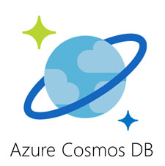

Slide 47
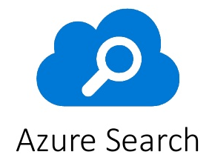

Slide 48
Jamstack
PROS
Better Performance
Cheaper Servers
Better Caching
More Security
Easy to scale
Better SEO
Better Developer Experience

Slide 49
Jamstack
PROBLEMS
Different costs to evaluate
External dependencies
Atomic build time
Hard for content editors

Slide 50


Slide 51
Thank you!
Web fgiuliani.com
Twitter @facundozurdo
GitHub @fgiuliani

